Slide 1
CSCI2100D AVL Trees

Slide 2
Review: Binary Search Tree (BST)
A binary search tree is a binary tree which satisfies the following properties.
Every element has a unique key.
All keys in a nonempty left subtree must be smaller than the key in the root of the subtree.
All keys in a nonempty right subtree must be larger than the key in the root of the subtree.
30
20
20
5
40
12
22
15
25
2
10
15
25
12
10
22

Slide 3
Insertion into a BST
Verify that the key is different from those of existing elements in the binary search tree.
If the search is unsuccessful, then we insert the element at the point the search terminated. Suppose the so-called point is a node in the binary search tree. Then, key can be inserted in either its left child node or its right child node depending on the key.
30
30
30
5
40
5
40
5
40
2
2
80
2
35
80
Original Tree
Insert 80
Insert 35

Slide 4
Insertion into a BST
Consider how to insert 40, 20, 60, 10, 50, 45, 30, 55, 70 and 52 into a binary search tree in order.

Slide 5
Deletion from a BST
The properties of binary search trees:
Where is the min/max element kept in a tree/subtree? Leftmost/Rightmost node?
Delete an element from a binary search tree in 3 cases:
delete a leaf node.
delete a non-leaf node with one child.
Put the single child in the place of the deleted node.
delete a non-leaf node with two children.
Find the smallest element from its right subtree, or
Find the largest element from its left subtree.
Put the chosen node in the place of the deleted node.

Slide 6
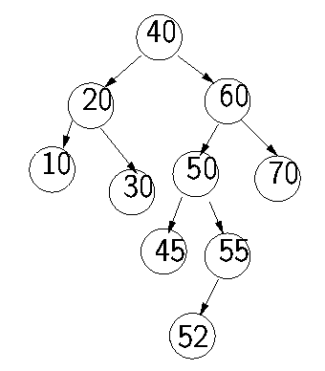
Deletion from a BST
Delete 10 from the above tree.
Delete 55 from the above tree.
Delete 60 from the above tree.

Slide 7
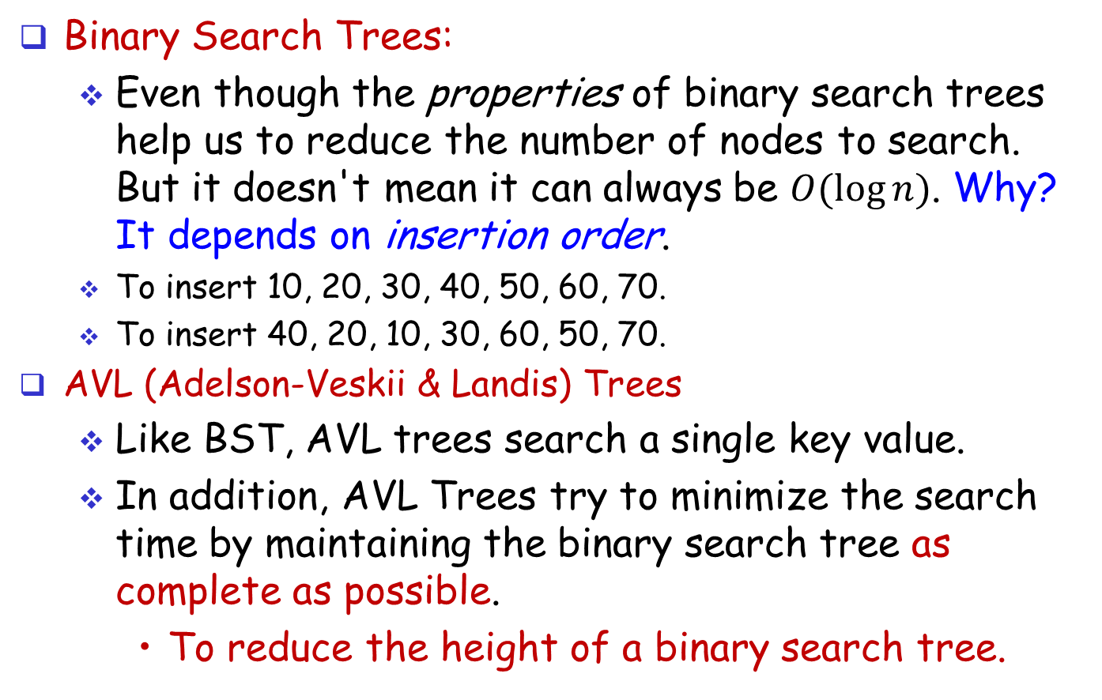
From BST to AVL Trees
Binary Search Trees:
Even though the properties of binary search trees help us to reduce the number of nodes to search. But it doesn't mean it can always be $O(log⁡n)$. Why? It depends on insertion order.
To insert 10, 20, 30, 40, 50, 60, 70.
To insert 40, 20, 10, 30, 60, 50, 70.
AVL (Adelson-Veskii & Landis) Trees
Like BST, AVL trees search a single key value.
In addition, AVL Trees try to minimize the search time by maintaining the binary search tree as complete as possible.
To reduce the height of a binary search tree.
40
10
20
60
20
10
30
50
70
70

Slide 8
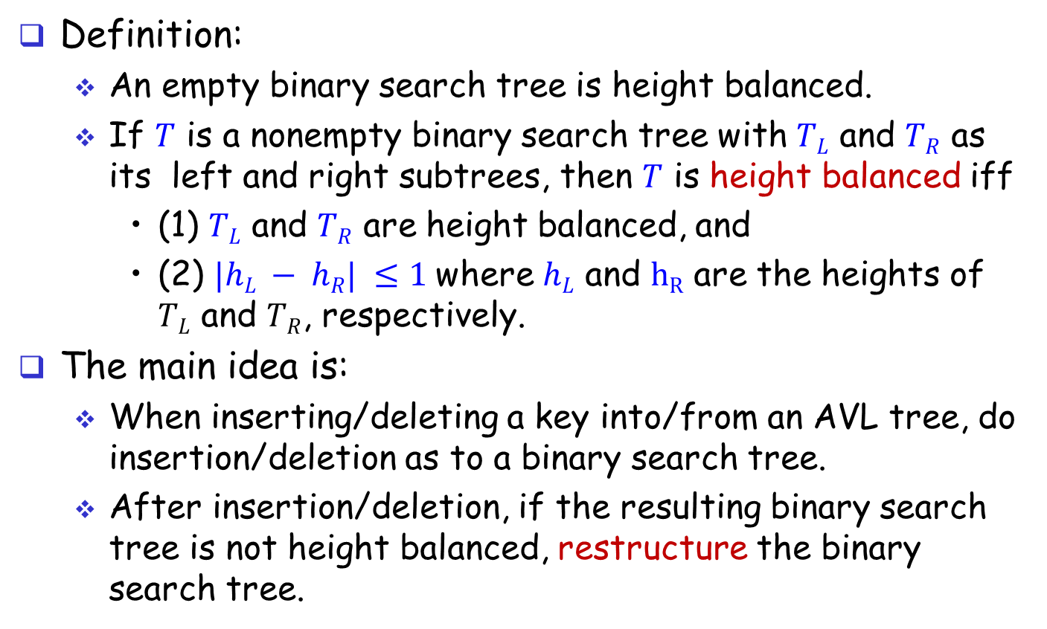
AVL Trees
Definition:
An empty binary search tree is height balanced.
If $T$ is a nonempty binary search tree with $TL$ and $TR$ as its left and right subtrees, then $T$ is height balanced iff
(1) $TL$ and $TR$ are height balanced, and
(2) $|hL − hR| ≤1$where $hL$ and $hR$ are the heights of $TL$ and $TR$, respectively.
The main idea is:
When inserting/deleting a key into/from an AVL tree, do insertion/deletion as to a binary search tree.
After insertion/deletion, if the resulting binary search tree is not height balanced, restructure the binary search tree.

Slide 9
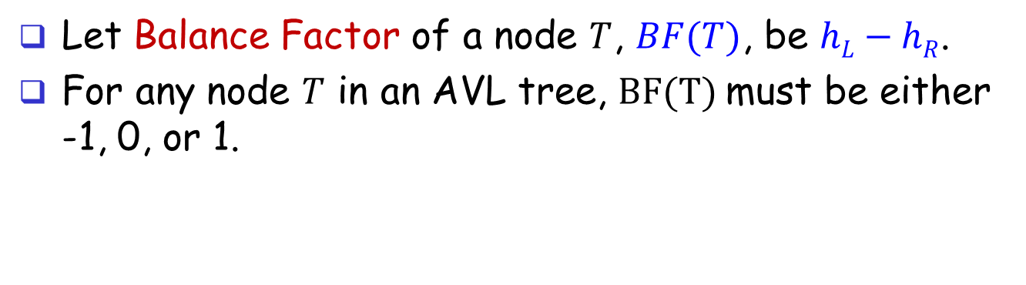
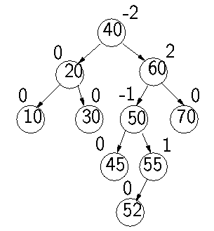
AVL Trees
Let Balance Factor of a node $T$, $BF(T)$, be $hL−hR$.
For any node $T$ in an AVL tree, $BF(T)$must be either -1, 0, or 1.

Slide 10
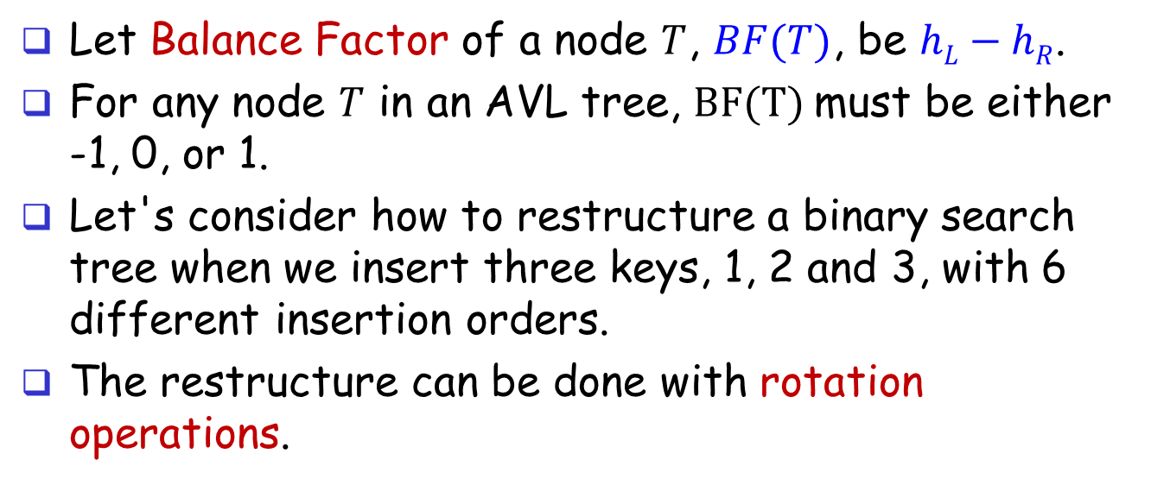
AVL Trees
Let Balance Factor of a node $T$, $BF(T)$, be $hL−hR$.
For any node $T$ in an AVL tree, $BF(T)$must be either -1, 0, or 1.
Let's consider how to restructure a binary search tree when we insert three keys, 1, 2 and 3, with 6 different insertion orders.
The restructure can be done with rotation operations.

Slide 11
Insert 3, 2, and 1
insert 3
insert 2
insert 1 (LL-Type)
After Rotation
0
1
2
3
0
2
3
3
0
1
0
0
2
2
1
3
0
1

Slide 12
Insert 3, 1, and 2
insert 3
insert 1
insert 2 (LR-Type)
After Rotation
0
2
0
1
3
3
3
2
0
-1
0
0
1
1
1
3
0
2

Slide 13
Insert 1, 2, and 3
insert 1
insert 2
insert 3 (RR-Type)
After Rotation
0
-1
-2
0
1
1
1
2
0
2
-1
0
0
2
1
3
0
3

Slide 14
Insert 1, 3, and 2
insert 1
insert 3
insert 2 (RL-Type)
After Rotation
0
-1
-2
1
0
1
1
2
0
1
3
0
0
3
1
3
0
2

Slide 15
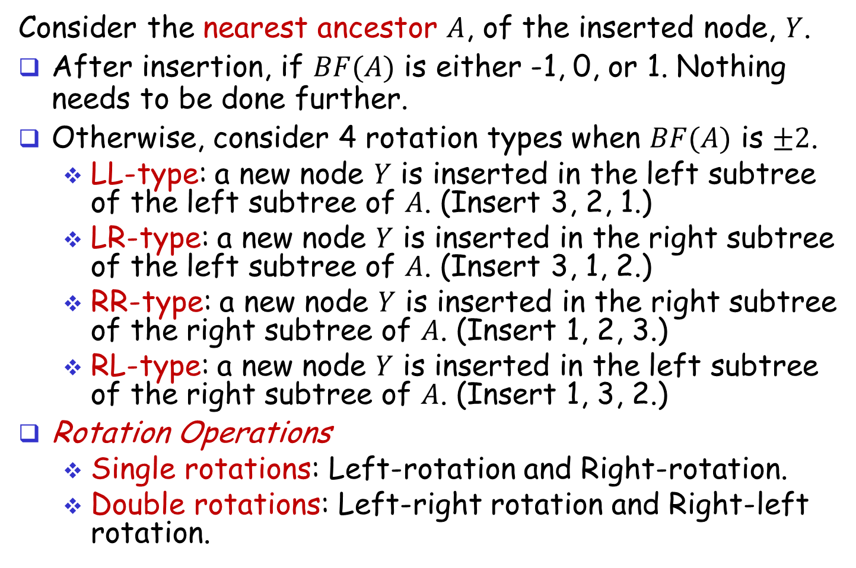
AVL Trees: Four Rotation Types
Consider the nearest ancestor $A$, of the inserted node, $Y$.
After insertion, if $BF(A)$ is either -1, 0, or 1. Nothing needs to be done further.
Otherwise, consider 4 rotation types when $BF(A)$ is $±2$.
LL-type: a new node $Y$ is inserted in the left subtree of the left subtree of $A$. (Insert 3, 2, 1.)
LR-type: a new node $Y$ is inserted in the right subtree of the left subtree of $A$. (Insert 3, 1, 2.)
RR-type: a new node $Y$ is inserted in the right subtree of the right subtree of $A$. (Insert 1, 2, 3.)
RL-type: a new node $Y$ is inserted in the left subtree of the right subtree of $A$. (Insert 1, 3, 2.)
Rotation Operations
Single rotations: Left-rotation and Right-rotation.
Double rotations: Left-right rotation and Right-left rotation.

Slide 16
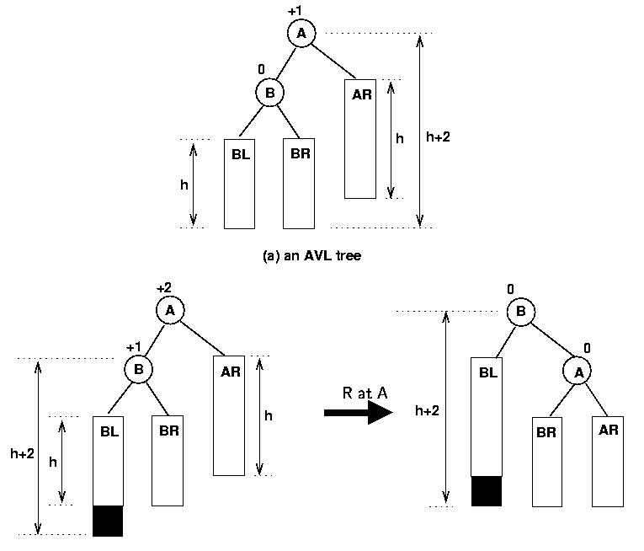
LL-type (Single Right Rotation)
Pivot point

Slide 17
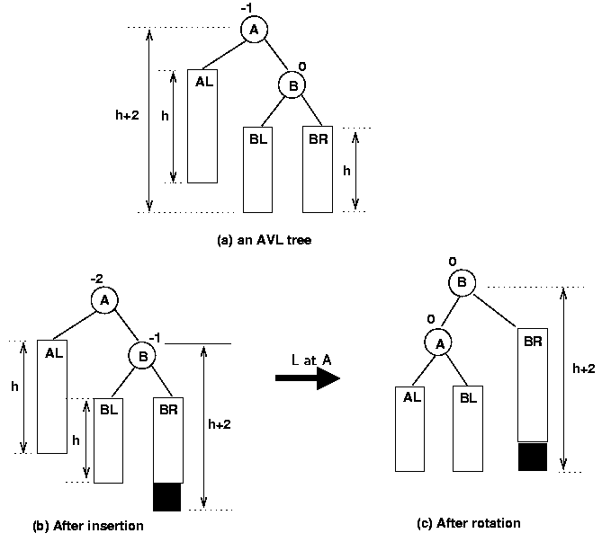
RR-type (Single Left Rotation)
Pivot point

Slide 18
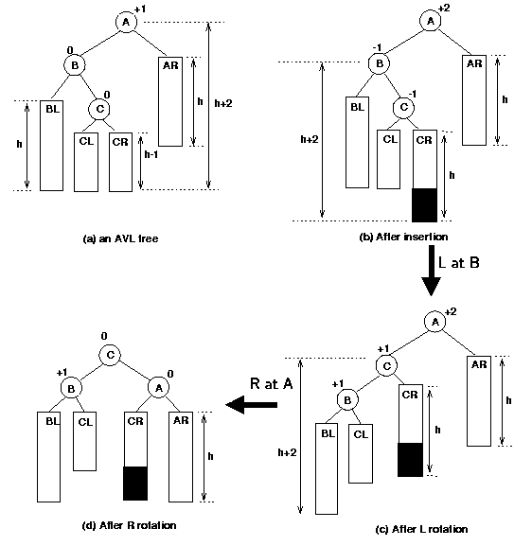
LR-type (Left-Right Double Rotation)
Pivot point

Slide 19
AVL Trees: Insertion
Consider how to insert 40, 20, 60, 10, 50, 45, 30, 55, 70 and 52 into a binary tree in order.
Note: RL-type is the mirror case of LR-type.
insert 40
insert 20
insert 60
insert 10
insert 50
0
1
0
1
0
40
40
40
40
40
0
0
0
1
0
1
1
20
20
60
20
60
20
60
0
0
0
10
10
50

Slide 20
Insert 45, 30, 55, and 70
After insert 50
insert 45
After Rotation
0
-1
0
40
40
LL-Type
R Rotation
40
1
1
1
2
1
0
20
60
20
60
20
50
Pivot point
0
0
0
1
0
0
0
10
50
10
50
10
45
60
0
45
Insert 55
Insert 70
Insert 30
-1
-1
40
40
0
40
0
0
20
-1
50
20
-1
50
0
0
20
50
0
0
0
1
0
0
0
0
10
30
45
60
10
30
45
60
0
0
0
0
10
30
45
60
0
0
0
55
55
70

Slide 21
Insert 52
Insert 52
After insert 70
-2
RL-Type
-2
-1
40
40
40
R Rotation
Pivot point
0
-2
0
0
-1
20
50
20
-2
50
20
50
0
0
0
1
0
0
0
-1
0
0
0
0
10
30
45
60
10
30
45
10
30
45
60
55
1
0
0
0
55
70
0
-1
55
70
52
60
0
0
52
-1
40
L Rotation
70
0
0
20
55
0
0
0
-1
10
30
50
60
0
0
0
45
52
70

Slide 22
Summary of Insertion
Only the nodes along the path from the insertion path (from the root to the newly added leaf) can become imbalanced.
It suffices to remedy only the lowest imbalanced node.

Slide 23
AVL Tree: Deletion
Deletion works in similar manner as insertion.
After deletion of a node, we may have an unbalanced tree. We must rotate to restructure the tree.

Slide 24
Case 1: Deletion of a leaf node
If the node to be deleted is a leaf node, simply remove it
-1
-1
40
40
0
0
0
0
20
55
20
55
0
0
0
-1
0
0
1
-1
10
30
50
60
10
30
50
60
0
0
0
0
0
45
52
70
45
70

Slide 25
Deletion of a non-leaf node
Case 2: The node to be deleted (denoted as u) has a right subtree
Find the smallest node (denoted as v) in the right subtree
Copy the key in v to node u
Case 2.1: if v is a leaf node, remove v
Case 2.2: Otherwise, it must hold that v has a right child w, which is a leaf (why?), but not left child. Set the key of v to that of w, and remove w from T.

Slide 26
Deletion of a non-leaf node
Case 3: If u has no right subtree
It must hold that u has a left child v, which is a leaf. (why?)
Set the key of u to that of v, and remove v from T.

Slide 27
Case 2.1 Example
Delete node 60
-1
-1
40
40
0
0
0
1
20
55
20
55
0
0
0
-1
0
0
0
0
10
30
50
60
10
30
50
70
0
0
0
0
0
45
52
70
45
52

Slide 28
Case 2.2 Example
Delete node 55
-1
-1
40
40
0
0
0
1
20
55
20
60
0
0
0
-1
0
0
0
0
10
30
50
60
10
30
50
70
0
0
0
0
0
45
52
70
45
52

Slide 29
Case 3 Example
Delete node 20
-1
-2
40
40
1
0
0
0
20
55
10
55
0
0
-1
0
-1
10
50
60
50
60
0
0
0
0
0
0
45
52
70
45
52
70

Slide 30
Imbalance after a deletion
Only the nodes along the deletion path may become imbalanced.
We fix each of them in the bottom-up order in exactly the same way as described for insertions, namely, using either a rotation or double rotation.
Unlike an insertion, we may need to remedy more than one imbalanced node.

Slide 31
RR Type
Delete node 20
-1
-2
1
40
40
Single rotation
55
1
0
0
-1
-1
20
0
55
10
55
40
60
0
0
-1
0
-1
0
0
0
10
50
60
50
60
10
50
70
0
0
0
0
0
0
0
0
45
52
70
45
52
70
45
52

Slide 32
LR Type
Delete 40
This rotation balances 73, but 30 is imbalanced
1
1
2
30
30
30
-1
1
-1
2
-1
0
15
40
15
73
15
36
deletion
rotation
1
-1
-1
0
1
-1
-1
1
-1
0
0
10
20
35
73
10
20
35
10
20
35
73
0
0
0
0
-1
0
0
-1
0
0
-1
3
17
25
36
3
25
36
3
25
17
17
0
27
0
27
0
27

Slide 33
LR Type
Balance node 30
So this deletion requires fixing two imbalanced nodes
2
0
30
20
Double rotation (left-right rotation) to balance 30
-1
0
1
0
15
36
15
30
1
-1
0
0
1
0
-1
0
10
20
35
73
10
17
25
36
0
0
0
-1
3
25
3
0
35
73
17
27
0
27

Slide 34
AVL Trees: Complexity
For an AVL Tree with n keys
Space consumption: O(n)
Time complexity:
Search for a key: O(logn)
Insertion: O(logn)
Deletion: O(logn)

